Slide 1
Name
Course title
Date

Slide 2
Rationale and goals of the project
Parking is a city resource that is useful to many
It allows access to delivery, emergency services and recreational facilities
Parking lots should be made easy to access so as to manage time
Investing in infrastructure that can control parking space is the best idea any city should consider
Notes:
Parking is a city resource that should not be taken for granted. Besides managing the street, parking also allows access to pick-up, delivery and emergency services.
If parking were made easy, it would allow for ease of access to recreational facilities and access to nature. People would neither prefer cycling nor walking over use of cars, which would also contribute to time management.
To better utilize parking space, we are going to use data from a specific city to determine whether it is sensible to invest in infrastructure that will help control parking space in the different parking lots.

Slide 3
Occupancy Rates
Median occupancy rate is different throughout the week
The median occupancy rates are higher during weekdays but lower during weekends
During weekdays, the median occupancy rate ranges from 84% to 92%. Saturday has 73% while Sunday has 55%
Box plots can be used to show occupancy rate for each day of the week
Notes:
To calculate the occupancy rate, we are going to divide the lot occupancy by the lot capacity from the data we’ve been given and then multiply the result by 100. the percentage arrived at should be rounded off to one decimal place. From what we calculated, we realized that we have a relatively high median occupancy rate during the weekdays than the weekend. The highest median occupancy rate experienced over the weekdays is 92% while that over the weekend is 73%. There are some days during the weekdays that seemed to have approximately the same median occupancy rate which was ranging between 91% and 92%. Saturday has a median occupancy rate of 73% while Sunday has a median occupancy rate of 55%. From the data we have prepared, we are going to prepare box plots for each day of the week.

Slide 4
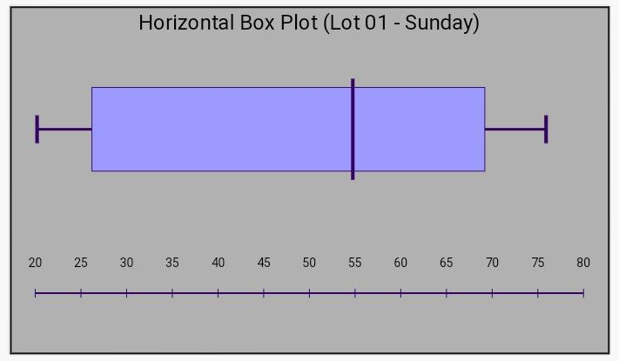
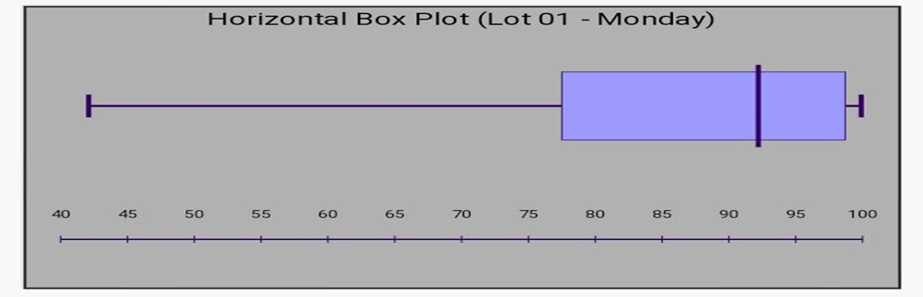
Box plot - Sunday and Monday
The following box plot shows occupancy rate for Sunday
The following box plot shows occupancy rate for Monday
Notes:
The box and whisker plots above shows occupancy rate for Sunday and Monday respectively. The descriptive statistics for these days are as follows:
Sunday – we had a sample size of 18
Median = 54.7
Minimum = 20.2
Maximum = 75.9
First quartile = 25.4
Third quartile = 69.8
Interquartile range = 44.5
Monday – we had a sample size of 18
Median = 92.2
Minimum = 42.1
Maximum = 99.9
First quartile = 75.5
Third quartile = 98.9
Interquartile range = 23.6
The box plot for both Sunday and Monday are skewed to the left. Sunday has a more scattered data because the box plot shows a wider distribution.

Slide 5
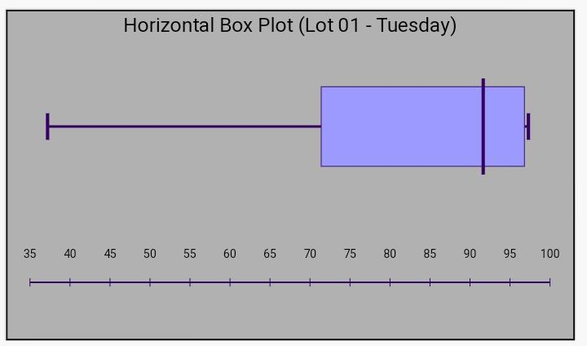
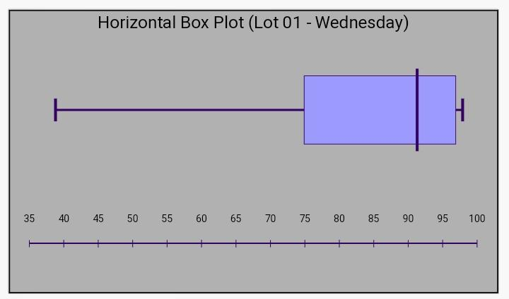
Box plot – Tuesday and Wednesday
The following box plot shows occupancy rate for Tuesday
The following box plot shows occupancy rate for Wednesday
Notes:
The box and whisker plots above shows occupancy rate for Tuesday and Wednesday respectively. The descriptive statistics for these days are as follows:
Tuesday – we had a sample size of 18
Median = 91.7
Minimum = 37.2
Maximum = 97.3
First quartile = 71.1
Third quartile = 96.8
Interquartile range = 25.7
Wednesday – we had a sample size of 18
Median = 91.3
Minimum = 38.8
Maximum = 97.9
First quartile = 74.8
Third quartile = 96.9
Interquartile range = 22.1
The box plot for both Tuesday and Wednesday are skewed to the left. They show almost the same skewness.

Slide 6
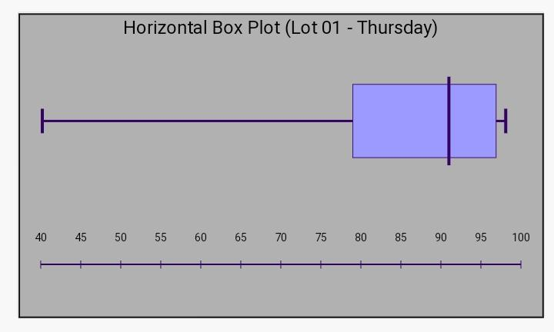
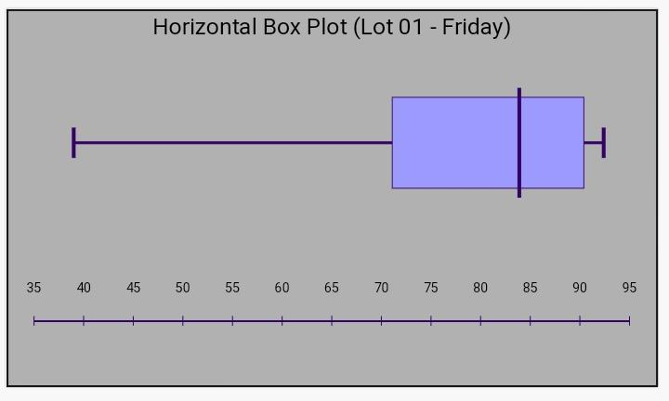
Box plot – Thursday and Friday
The following box plot shows occupancy rate for Thursday
The following box plot shows occupancy rate for Friday
Notes:
The box and whisker plots above shows occupancy rate for Thursday and Friday respectively. The descriptive statistics for these days are as follows:
Thursday – we had a sample size of 18
Median = 91
Minimum = 40.2
Maximum = 98.1
First quartile = 77.9
Third quartile = 96.9
Interquartile range = 19.1
Friday – we had a sample size of 18
Median = 83.9
Minimum = 39.0
Maximum = 92.4
First quartile = 69.8
Third quartile = 90.4
Interquartile range = 20.6
The box plot for both Thursday and Friday are skewed to the left. They also show skewness that is almost the same.

Slide 7
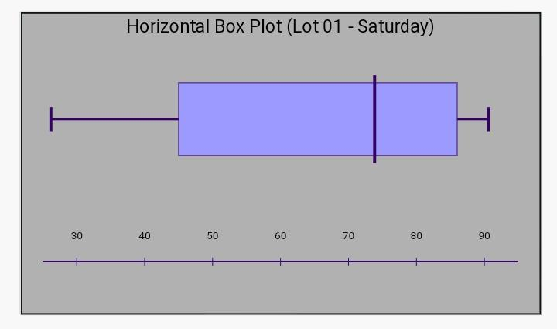
Box plot – Saturday
The following box plot shows occupancy rate for Saturday
Notes:
The box and whisker plot above shows occupancy rate for Saturday respectively. The descriptive statistics for this day is as follows:
Saturday – we had a sample size of 18
Median = 73.9
Minimum = 26.2
Maximum = 90.6
First quartile = 43.2
Third quartile = 86.4
Interquartile range = 43.2
The box plot for Saturday is also skewed to the left. Saturday seem to have a more scattered data because the box plot shows a wider distribution.

Slide 8
Box plot – parking lot 01 and 02
Occupancy rate for parking lot 01
Occupancy rate for parking lot 02
Notes:
The box and whisker plots above shows occupancy rate for parking lot 1 and 2 respectively. The descriptive statistics for the parking lots are as follows:
Parking lot 1 – we had a sample size of 18
Minimum = 20.2
First quartile = 26.8
Median = 54.8
Third quartile = 69.1
Maximum = 75.9
Parking lot 2 – we had a sample size of 18
Minimum = 29.2
First quartile = 56.9
Median = 100.0
Third quartile = 100.0
Maximum = 100.0
The box plot for parking lot 1 and lot 2 are skewed to the left.

Slide 9
Box plot – parking lot 03 and 04
Occupancy rate for parking lot 03
Occupancy rate for parking lot 04
Notes:
The box and whisker plots above shows occupancy rate for parking lot 3 and 4 respectively. The descriptive statistics for the parking lots are as follows:
Parking lot 3 – we had a sample size of 18
Minimum = 2.2
First quartile = 15.2
Median = 76.1
Third quartile = 99.5
Maximum = 100.1
Parking lot 4 – we had a sample size of 18
Minimum = 2.5
First quartile = 10.4
Median = 29.7
Third quartile = 41.7
Maximum = 46.6

Slide 10
Box plot – parking lot 05 and 06
Occupancy rate for parking lot 05
Occupancy rate for parking lot 06
Notes:
The box and whisker plots above shows occupancy rate for parking lot 5 and 6 respectively. The descriptive statistics for the parking lots are as follows:
Parking lot 5 – we had a sample size of 18
Minimum = 8.7
First quartile = 11.5
Median = 27.8
Third quartile = 38.5
Maximum = 63.2
Parking lot 6 – we had a sample size of 18
Minimum = 6.8
First quartile = 7.7
Median = 8.0
Third quartile = 14.2
Maximum = 20

Slide 11
Box plot – parking lot 07 and 08
Occupancy rate for parking lot 07
Occupancy rate for parking lot 08
Notes:
The box and whisker plots above shows occupancy rate for parking lot 7 and 8 respectively. The descriptive statistics for the parking lots are as follows:
Parking lot 7 – we had a sample size of 18
Minimum = 33.6
First quartile = 36.2
Median = 47.7
Third quartile = 64.9
Maximum = 71.9
Parking lot 8 – we had a sample size of 18
Minimum = 8.1
First quartile = 12.8
Median = 23.3
Third quartile = 29.6
Maximum = 36.5

Slide 12
Box plot – parking lot 09
Occupancy rate for parking lot 09
Notes:
The box and whisker plot above shows occupancy rate for parking lot 9 respectively. The descriptive statistics for the parking lot is as follows:
Parking lot 9 – we had a sample size of 18
Minimum = 24.3
First quartile = 29.1
Median = 37.6
Third quartile = 44.2
Maximum = 46.7

Slide 13
Scatter plot – parking lot 01 and 02
Notes:
The scatter plots above have been constructed using the occupancy rate and the time of day for parking lot 01 and parking lot 02. It gives a picture about the relationship between the occupancy rate and the time when the occupancy was measured.
According to parking lot 01, there is a positive relationship between occupancy rate and time because the data shows an uphill pattern as you move from left to right. Parking seem to take place more during afternoons than morning hours. We have observed the same case with parking lot 02 as well.

Slide 14
Scatter plot – parking lot 03 and 05
Notes:
The scatter plots above have been constructed using the occupancy rate and the time of day for parking lot 03 and parking lot 05. The two variables give a picture about how they relate.
We can also see that there is a positive relationship between occupancy rate and time for both parking lot 03 and parking lot 05 because the data shows an uphill pattern as you move from left to right. According to the scatter plot, occupancy rate is higher during the afternoons than morning hours.

Slide 15
Recommendation
Occupancy rate is useful in determining day and time parking lots are occupied
The city should invest in such infrastructure to ease access to parking space and manage time.
Since the App gives us an opportunity to control parking space and manage time.The city should therefore proceed with the implementation of the Smart Parking Space App
Notes:
The occupancy rate has played a good role in helping us determine what days and time parking lots are more occupied. By utilizing the data above, I have realized that parking space can easily be accessed because the App gives us an opportunity to control parking space and manage time. The city should therefore proceed with the implementation of the Smart Parking Space App

Slide 16
References
Grodi, R., Rawat, D. B., & Rios-Gutierrez, F. (2016, March). Smart parking: Parking occupancy monitoring and visualization system for smart cities. In SoutheastCon 2016 (pp. 1-5). IEEE.
Almirall, E., Wareham, J., Ratti, C., Conesa, P., Bria, F., Gaviria, A., & Edmondson, A. (2016). Smart cities at the crossroads: New tensions in city transformation. California Management Review, 59(1), 141-152.

